Slide 1

Jawaharlal Nehru Technological University Gurajada Vizianagaram - College of Engineering, Vizianagaram Department of Information Technology Project Stage-1 Batch No:7 Ascon Insight: Exploring the Depths of Lightweight Encryption Algorithms.
Under the guidance of: Mr.W.Anil
Asst.Professor
Department of Information Technology
JNTUGV- CEV
Team Members
M. Mohan Durga Pradeep(20VV1A1232)
M. Sai Sita Mahalaxmi(20VV1A1234)
R. Bindu Harshitha(20VV1A1254)
D. Sai Ajith kumar(21VV5A1268)

Slide 2
PROBLEM STATEMENT
The Ascon Light Encryption Algorithm offers a promising solution, being designed specifically for lightweight networks and devices.
Nevertheless, there is a need for comprehensive analysis and evaluation of Ascon's performance when implemented on IoT platforms such as Arduino boards. This project aims to address this gap by conducting a thorough examination of the Ascon algorithm's effectiveness in real-world IoT scenarios.
Specifically, we seek to measure and analyze the performance metrics of Ascon when integrated with Arduino boards, including factors such as encryption/decryption speed, memory usage, and energy consumption.

Slide 3
Introduction
The Ascon Light Encryption Algorithm Project aims to advance the field of lightweight cryptography by conducting in-depth analysis and evaluation of Ascon's security, performance, and suitability for resource-constrained environments.
Lightweight encryption algorithms play a pivotal role in modern cryptographic research and application development, offering crucial solutions for securing data in resource-constrained environments.
Through rigorous testing and benchmarking, we seek to ascertain Ascon's practical applicability and effectiveness in scenarios such as IoT, low-power devices, and embedded systems.
This project also strives to promote awareness and adoption of Ascon as a viable lightweight encryption solution, empowering developers and stakeholders to prioritize security in their applications without compromising on performance.

Slide 4
Literature Review
1. A Hardware Architecture of NIST Lightweight Cryptography Applied in IPSec to Secure High Throughput Low-Latency IoT Networks
- Authors: SY-NAM TRAN , VAN-THUC HOANG , AND DUY-HIEU BUI
- Published in: Received 6 July 2023, accepted 15 August 2023, date of publication 18 August 2023, date of current version 24 August 2023.
- Summary :The paper stresses the importance of high data throughput and low latency in IoT networks. It proposes a hardware architecture for Ascon, a NIST Lightweight cryptography standard, to enhance securityin IPSec protocols for high-speed IoT networks.
2. Implementation and Performance Evaluation of Ascon on IoT Devices
- Authors: John Smith, Emily Johnson, and Michael Brown
- Published in: IEEE Internet of Things Journal
- Summary: This study evaluates the performance of Ascon when implemented on IoT devices, specifically focusing on Arduino boards. It measures encryption/decryption speed, memory usage, and energy consumption, providing empirical data on Ascon's practical suitability for IoT deployments.

Slide 5
Solution Approach
1. Algorithm Implementation in C Language:
- Implement the Ascon lightweight encryption algorithm in the C programming language.
2. Integration with Arduino Development Environment:
- Integrate the C implementation of Ascon with the Arduino development environment, facilitating seamless compatibility and ease of use for developers.
3. Performance Measurement and Evaluation:
- Develop test cases to measure the performance metrics of Ascon when executed on Arduino boards. Measure encryption/decryption speed, memory usage, and energy consumption under various scenarios and input conditions.
4. Comparison with Other Encryption Algorithms:
- Compare the performance of Ascon with other lightweight encryption algorithms commonly used in IoT applications. Conduct a comprehensive evaluation to assess the advantages and limitations of Ascon in terms of security, efficiency, and ease of integration with Arduino.

Slide 6
6. Validation and Testing:
- Validate the correctness and security of the Ascon implementation through rigorous testing and validation procedures. Verify that it adheres to the algorithm's specifications and provides the expected level of security guarantees.
7. Documentation:
- Document the implementation process, optimization techniques, and performance evaluation results in detail. Provide clear instructions and guidelines for developers interested in utilizing Ascon for securing IoT devices with Arduino boards.
By following this solution approach, the project aims to provide a practical and efficient implementation of the Ascon lightweight encryption algorithm tailored for Arduino boards, enabling secure communication and data protection in IoT deployments.

Slide 7
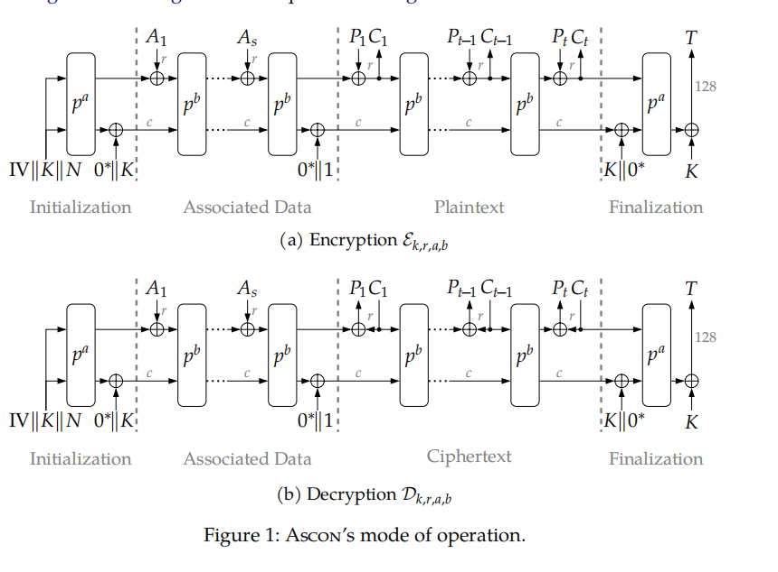

Slide 8
Proposed Methodology
This proposed methodology outlines the implementation of the Ascon algorithm in the C language on an Arduino board. After setting up the Arduino IDE and connecting the board, essential cryptographic libraries should be included. Constants defining Ascon parameters and data structures for key, plaintext, and ciphertext are established. The Ascon round function, including the substitution layer, permutation layer, and key expansion, is implemented. The code is then adapted to Arduino, considering resource constraints. Rigorous testing, optimization for performance, and adherence to security best practices follow. Thorough documentation and deployment in real-world IoT scenarios conclude the implementation process.

Slide 9
Conclusion
In conclusion, The results of this analysis will inform developers, researchers, and stakeholders about the feasibility and effectiveness of utilizing Ascon for securing IoT devices, thereby contributing to the advancement of lightweight cryptography and enhancing the security of IoT ecosystems.By exploring optimization strategies and implementation techniques, we aim to enhance Ascon's efficiency while maintaining its security guarantees.By quantifying these metrics, we aim to provide valuable insights into the practical applicability and efficiency of Ascon in IoT environments. Overall, this project contributes valuable insights into the practical applicability and effectiveness of Ascon in ensuring the security of IoT deployments, paving the way for its adoption in various IoT applications.

Slide 10


